Slide 1

MICROSPECTRA SOFTWARE TECHNOLOGIES PVT. LTD.
INTRODUCTION TO
DATA SCIENCE ARTIFICIAL INTELLIGENCE
MACHINE LEARNING DEEP LEARNING
Topic:- Artificial Intelligence(lect no:-5)
Certification & Internship Program

Slide 2
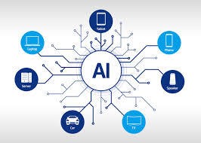
INTRO TO ARTIFICIAL INTELLIGENCE
What Is Artificial Intelligence ?
Definition:Artificial Intelligence (AI) is a science that's used to construct intelligence using hardware and software solutions.
It is inspired by reverse engineering, for example, in the way that neurons work in the human brain. Our brain consists of small units called neurons, and networks of neurons called neural networks. Beyond neural networks, there are many other models in neuroscience that can be used to solve real-world problems in artificial intelligence.
MICROSPECTRA SOFTWARE TECHNOLOGIES PVT.LTD

Slide 3
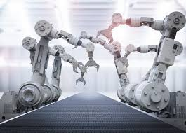
INTRO TO ARTIFICIAL INTELLIGENCE
How does AI Solve Real World Problems?
Artificial intelligence automates human intelligence based on the way
human brain processes information.
AI makes computers appear to think like humans.
AI is performed by computers that are executing low-level instructions.
AI may stimulate human senses and thinking processes for specialized
fields.
www.microspectra.in

Slide 4
INTRO TO ARTIFICIAL INTELLIGENCE
Diversity of Disciplines
In order to create a usable AI solution, different disciplines are involved.
Robotics: To move objects in space
Algorithm Theory: To construct efficient algorithms.
Statistics: To derive useful results, predict the future, and analyze the past.
Psychology: To model how the human brain works.
Software Engineering: To create maintainable solutions that endure the
test of time.
Computer Science or Computer Programming: To implement our
software solutions in practice
Mathematics: To perform complex mathematical operations.
Control Theory: To create feed-forward and feedback systems
Information Theory: To represent, encode, decode, and compress information
Graph Theory: To model and optimize different points in space and to represent hierarchies
Physics: To model the real world
Computer Graphics and Image Processing to display and process images and movies
International Certifications & Internship Programs

Slide 5
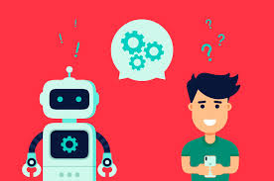
INTRO TO ARTIFICIAL INTELLIGENCE
Fields and Applications of Artificial
Intelligence?
Simulation of Human Behavior
Humans have five basic senses simply divided into visual, auditory, kinesthetic,olfactory, and gustatory. However, for the purposes of understanding how to create intelligent machines, we can separate disciplines as follows:
Listening & Speaking
Understanding Language
Remembering Things.
Thinking.
Seeing.
Moving.
Microsoft Technology Associate Certification In Python

Slide 6
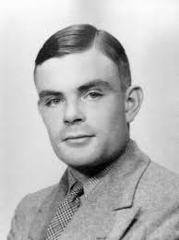
INTRO TO ARTIFICIAL INTELLIGENCE
Simulating Intelligence – The Turing Test
Alan Turing, the inventor of the Turing machine, an abstract concept that's used
in algorithm theory, suggested a way to test intelligence. This test is referred to
as the Turing test in AI literature
Using a text interface, an interrogator chats to a human and a chatbot. The job of the chatbot is to mislead the interrogator to the extent that they cannot tell whether the computer is human or not.
What disciplines do we need to pass the Turing test?
First of all, we need to understand a spoken language to know what the interrogator is saying. We do this by using Natural Language Processing (NLP). We also have to respond.
We need to be an expert on things that the human mind tends to be interested in. We need to build an Expert System of humanity, involving the taxonomy of objects and abstract thoughts in our world, as well as historical events and even Emotions.
Microsoft Technology Technology Associate In Web Development

Slide 7
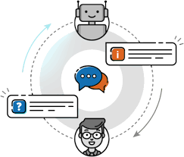
INTRO TO ARTIFICIAL INTELLIGENCE
AI Tools and Learning Models
Intelligent Agents
When solving AI problems, we create an actor in the environment that can
gather data from its surroundings and influence its surroundings. This actor is called an intelligent agent.
An intelligent agent:
Is autonomous
Observes its surroundings through sensors
Acts in its environment using actuators
Directs its activities toward achieving goals
Internship Progarm in AI, ML, DL, Data Science

Slide 8
INTRO TO ARTIFICIAL INTELLIGENCE
Classification and Prediction
Different goals require different processes. Let's explore the two most popular types of AI reasoning: classification and prediction.
Classification
a process for figuring out how an object can be defined in terms of another object. For instance, a father is a male who has one or more children.
If Jane is a parent of a child and Jane is female, then Jane is a mother. Also, Jane
is a human, a mammal, and a living organism. We know that Jane has a
nationality as well as a date of birth.
Prediction
the process of predicting things, based on patterns and probabilities. For instance, if a customer in a standard supermarket buys organic
milk, the same customer is more likely to buy organic yoghurt than the average
Customer.
Microsoft Technology Technology Associate In Web Development

Slide 9
INTRO TO ARTIFICIAL INTELLIGENCE
Learning Models
The process of AI learning can be done in a supervised or unsupervised way.
Supervised learning is based on labeled data and inferring functions from
training data.
Linear regression is one example.
Unsupervised learning is based on unlabeled data and often works on cluster analysis.
Internship Progarm in Web Development

Slide 10
